Slide 1
Introduction to Machine Learning: A Practical Overview
Faculty Development Programme on
“Data Analytics using Python/R Programming”
Department of Computer Science and Engineering,
National Institute of Technology Puducherry, Karaikal
Sponsored by: AICTE Training and Learning Academy (ATAL)
Dr. Ajit Kumar
Post Doctoral Researcher,
Soongsil University, Seoul, South Korea

Slide 2
Content
Programming to Training
Introduction to Machine Learning
Data type, features and Representation
Hands-on: Scikit-learn and Python modules
Trend in Machine Learning

Slide 3
Computing
Processing
Input
Output

Slide 4
Programming
Processing
(Program:
by User)
Input
Output
Processing
(Program:
by User)
Output
Input

Slide 5
Training
Method / Approach
Processing
(Program /model)
*Output
Input

Slide 6
Training ..
Method / Approach
(Decision Tree, Regression , SVM etc.)
*Output (classes)
Processing
(Program /model)
Output
Input
1. Text
2. Images
3. Video
4. Audio
5. Numeric
6. Others
Class label
Cluster
Numeric value

Slide 7
Machine Learning
Training
Model
Data

Slide 8






Machine Learning:data
Training
Pre-processing
Model
Data

Slide 9
Machine Learning : Feature
Training
Pre-processing
Model
Feature Extraction
Feature Selection
Data

Slide 10
Machine Learning : Pipeline
Training,
Testing,
Tuning,
validation
Pre-processing
Model
result
Deployment
Feature Extraction
Feature Selection
Test Input
Data

Slide 11
Machine Learning
It gives computers the ability to learn without being explicitly programmed. Arthur Samuel
A computer program is said to 'learn' from experience E
with respect to some class of tasks T and performance
measure P, if its performance at tasks in T, as measured by P, improves with experience E. Tom M. Mitchell

Slide 12
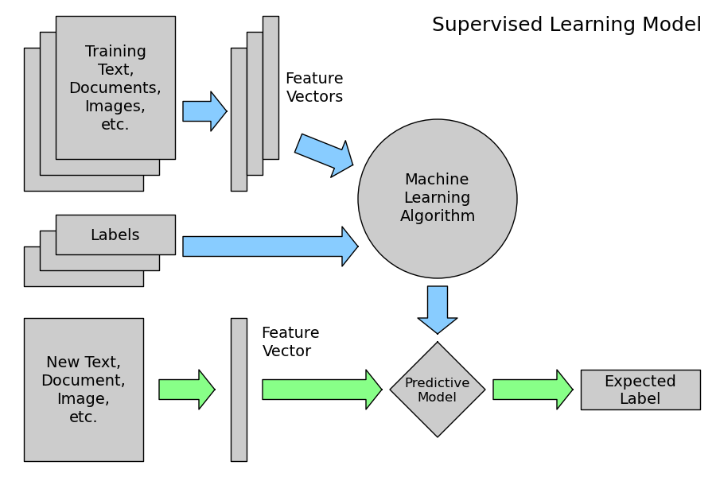
Supervised Learning

Slide 13
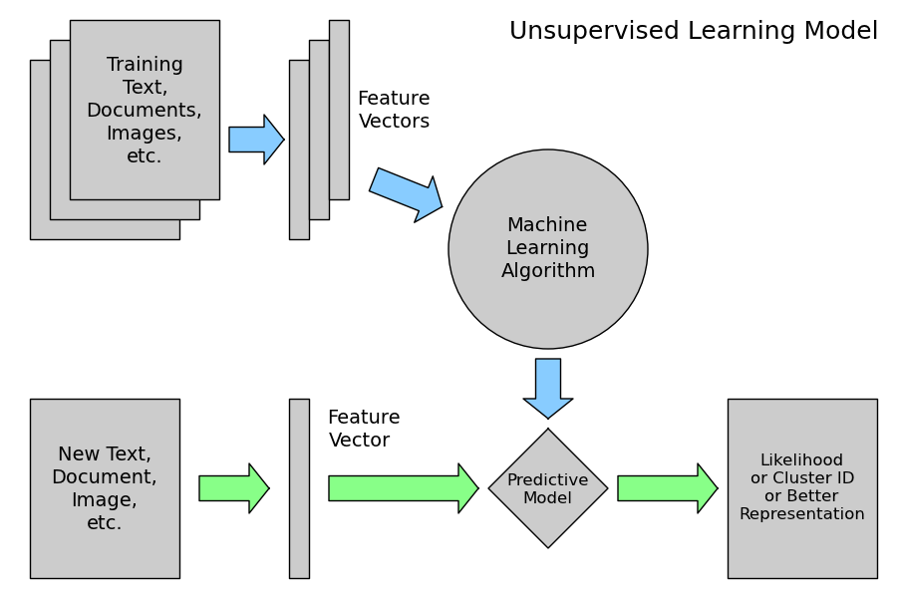
Unsupervised Learning

Slide 14
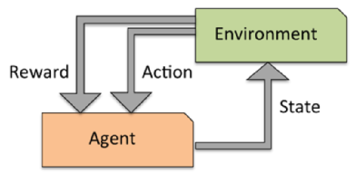
Reinforcement Learning

Slide 15
Learning Methods
Semi-supervised
Active learning
Online Learning
Ensemble Learning
Transfer Learning
Self-supervised learning
Deep learning
One-shot learning
Continual Learning
Federated Learning
……..
https://machinelearningmastery.com/types-of-learning-in-machine-learning/

Slide 16
Machine Learning frameworks and Tools
Scikit-learn
Tensorflow, pytorch,
keras->(CNTK, R, Theano, PlaidML)
Spark ML (java, scala), Torch (Lua)
Hugging face

Slide 17
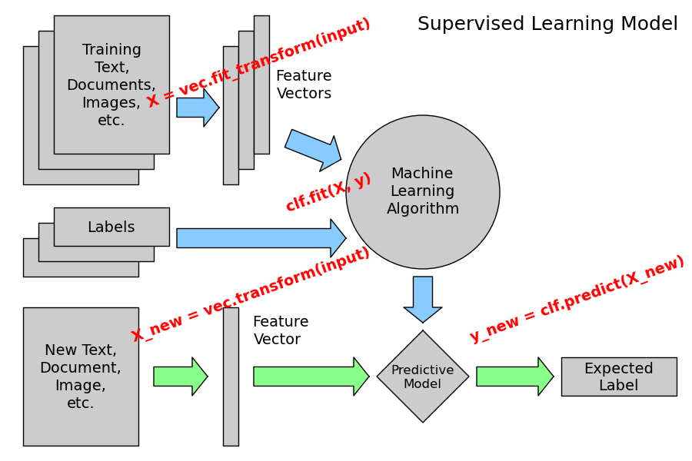
Scikit-learn

Slide 18
Scikit-learn
Simple and Efficient
Open source
Faster
Built on Python eco-system (numpy, scipy, matplotlib etc.)

Slide 19
Scikit-learn
Load data (numpy, pandas , scikit-learn)
Pre-process data
Create/ instantiate model clf = ModelName()
Train and test model (clf.fit(X,y), clf.fit(X))
Evaluate model clf.score()
Save/load model

Slide 20
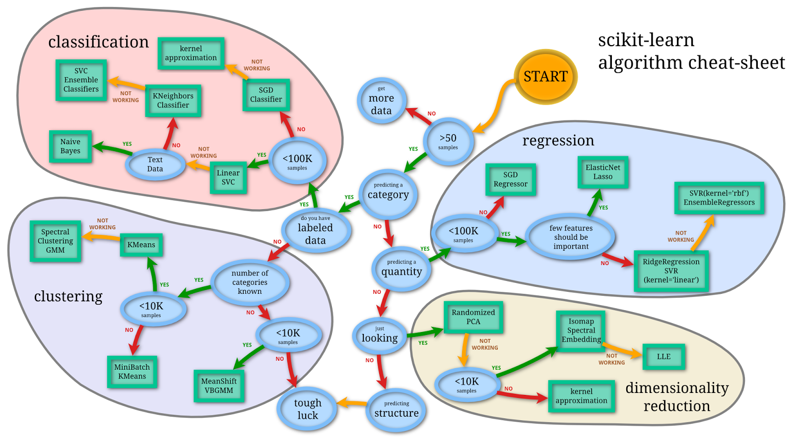
Scikit-learn algo cheat-sheet

Slide 21
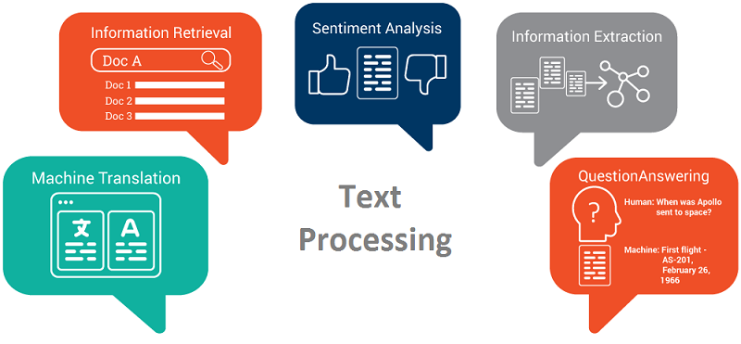
Text Processing

Slide 22
Text Data
Liang, Hong, et al. "Text feature extraction based on deep learning: a review." EURASIP journal on wireless communications and networking 2017.1 (2017): 1-12.
Minaee, Shervin, et al. "Deep Learning--based Text Classification: A Comprehensive Review." ACM Computing Surveys (CSUR) 54.3 (2021): 1-40.

Slide 23
Text feature extraction
Non- Deeplearning
Filtration (word frequency, information gain, and
mutual information method)
Fusion (Weighted KNN )
Mapping (LSI (latent semantic index) and PCA.)
Clustering (CHI Square, Concept indexing)
Deep learning based features
Autoencoder, RBM, DBN,CNN, RNN)

Slide 24
Text Data Pre-processing
Tokenization — convert sentences to words
Removing unnecessary punctuation, tags
Removing stop words — frequent words such as ”the”, ”is”, etc. that do not have specific semantic
Stemming — words are reduced to a root by removing inflection through dropping unnecessary characters, usually a suffix.
Lemmatization — Another approach to remove inflection by determining the part of speech and utilizing detailed database of the language.

Slide 25
Text Data Pre-processing
NLTK
Python + Requests + BeautifulSoup (Data scrapping)

Slide 26
Text feature representation
Bag-of-words
We make the list of unique words in the text corpus called vocabulary.
Then we can represent each sentence or document as a vector with each word represented as 1 for present and 0 for absent from the vocabulary.
count the number of times each word appears in a document.
Term Frequency (TF), Inverse Document Frequency (IDF), TF-IDF I.e. (TF *IDF)
Word2Vec, GLpve
Word2vec takes as its input a large corpus of text and produces a vector space with each unique word being assigned a corresponding vector in the space. Word vectors are positioned in the vector space such that words that share common contexts in the corpus are located in close proximity to one another in the space.

Slide 27
Audio features : Survey
Alías, Francesc, Joan Claudi Socoró, and Xavier Sevillano. "A review of physical and perceptual feature extraction techniques for speech, music and environmental sounds." Applied Sciences 6.5 (2016): 143.

Slide 28
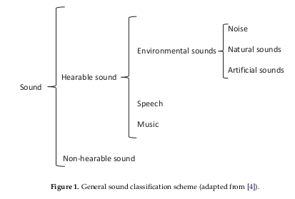
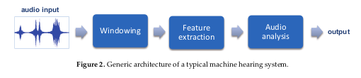
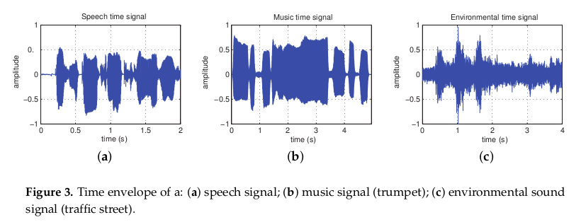
Audio

Slide 29
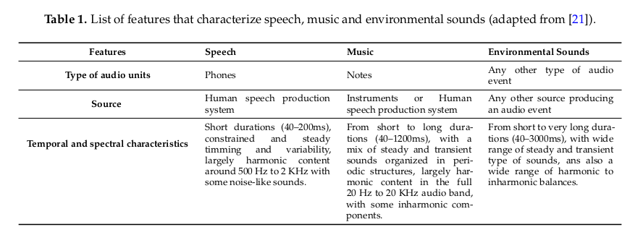
Audio characteristic

Slide 30
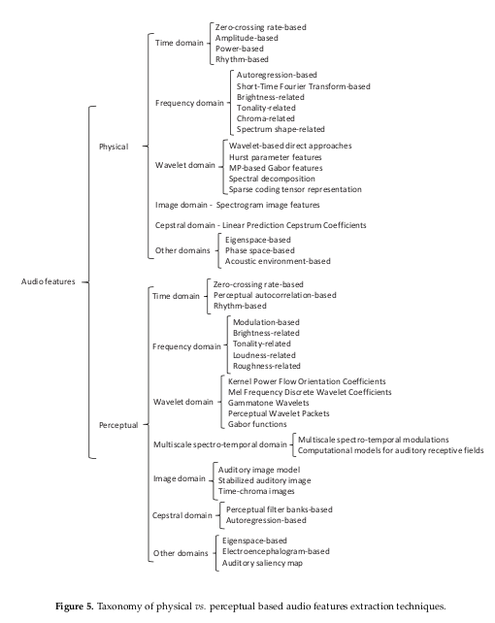
Audio features

Slide 31
Working with Audio
librosa
torchaudio
scipy.io

Slide 32
Image Data
ping Tian, Dong. "A review on image feature extraction and representation techniques." International Journal of Multimedia and Ubiquitous Engineering 8.4 (2013): 385-396.

Slide 33
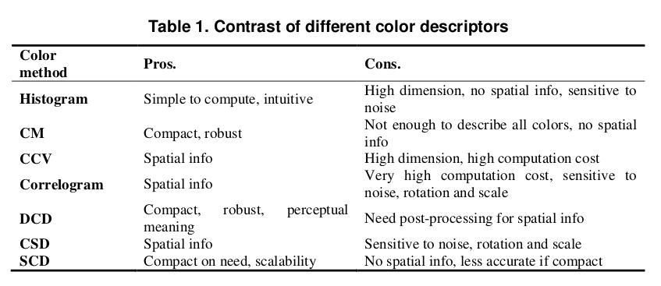
Image Data:color descriptors

Slide 34
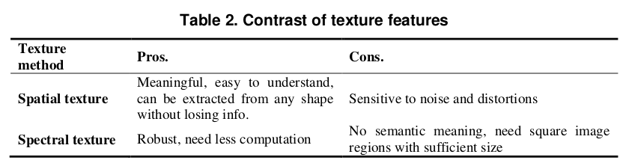
Image Data:Texture

Slide 35
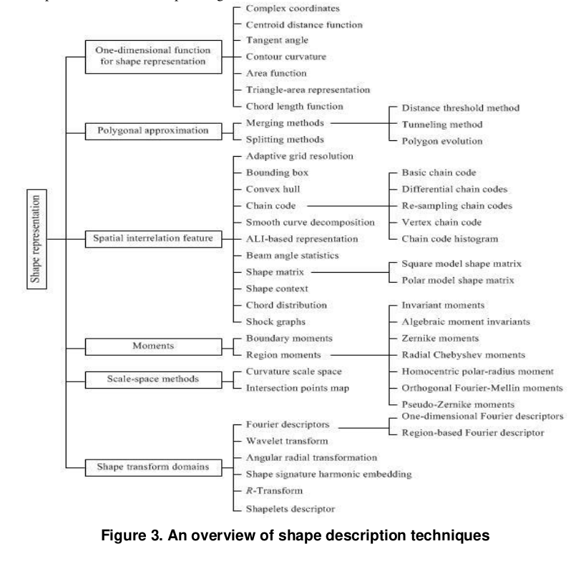
Image Data:shape

Slide 36
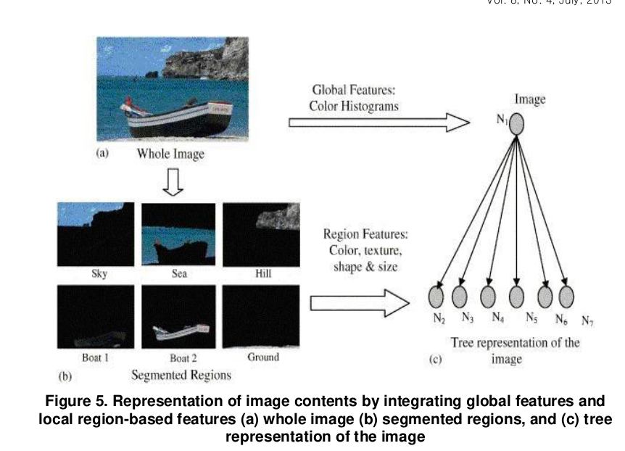
Image Data: Representation

Slide 37
Data processing
Text | Bag-of-words, transformer (BERT) etc. | NLTK, Huggingface
Image | HoG, Fog, etc | Scikit-image, opencv-python, PIL, openpose,
Video | Video to frame | Scikit-image, opencv
Audio | Spectrogram, malspectogram etc.
Exe, APK | Header info, byte frequency , permission count etc | Pefile, androguard

Slide 38
Data-centric Machine Learning

